Slide 1






Smart Decisions with Hotel Booking Analytics
Hotel booking data analysis to reduce cancellations and optimize revenue.

Slide 2



Aliens
About Us
We are a passionate team of data analysts who collaborated to explore and interpret hotel booking data.
Our project journey—from data wrangling and analysis to final insights—was driven by curiosity, teamwork, and a shared goal:
Transforming data into meaningful business decisions.
Team Members
Alaa Gabr
Eman Abdelrahman
Hagar Wagdi

Slide 3

Feature Engineering
Outlier Detection & Removal
Handling Missing Values
Data Cleaning & Preprocessing
Data Type Standardization
Outlier Detection & Removal
Booking behavior
Customer demographics
Dataset Overview
Data Exploration & Understanding
End-to-End Pipeline for Hotel Booking Data Analysis
Exploratory Data Analysis (EDA)
Cancellation patterns
Seasonal trends
Feature correlations
Final Recommendations
Business Decision-Making
Dashboard Reporting
starts with Dataset → Exploration → Cleaning → EDA → Recommendations.

Slide 4



Objective
Project Goal
Specific Objectives
To analyze hotel booking behavior and discover patterns that influence cancellations, customer preferences, and booking trends.
Understand customer booking behavior
Identify cancellation risk factors
Analyze seasonal and market segment trends
Provide actionable insights for hotel management decisions

Slide 5



Data Exploration & Understanding
Objective:
Gain a comprehensive understanding of the dataset's structure, distribution, and key attributes before deep analysis.
Initial Focus Areas:
- Dataset structure and column types
- Categorical vs. numerical variable identification
- Distribution, trends, and potential anomalies
- Relationship between features and cancellations

Slide 6


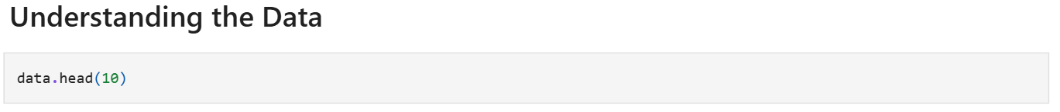
Dataset Overview
Dataset Summary:
Source: Hotel Booking Demand Dataset
Duration: July 2015 – August 2017
Total Records: 119,390
Hotels Covered: City Hotel & Resort Hotel
Features: 32 (including customer details, booking information, and stay data)
Key Columns: is_canceled,lead_time, arrival_date , deposit_type, customer_type, adr, market_segment, total_of_special_requests

Slide 7


Data Cleaning & Preprocessing
Objective:
Ensure the dataset is reliable, consistent, and ready for insightful analysis.
Key Activities:
Imputation of missing values
Outlier detection and removal
Standardization of formats and categories
Elimination of invalid records
Feature enhancement via derived variables

Slide 8
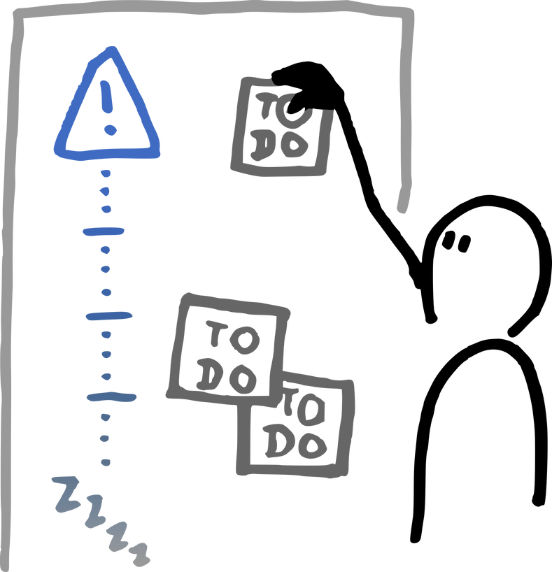
Handling Missing Values
Handling missing values ensures accurate analysis, reliable models, and trustworthy insights.
Column | Missing Percentage | Cleaning Strategy
children | 0.4% Missing | Impute with mode
country | 94.3% Missing | This can either be dropped
agent | 13.6% Missing | Replace missing values with "Unknown"

Slide 9

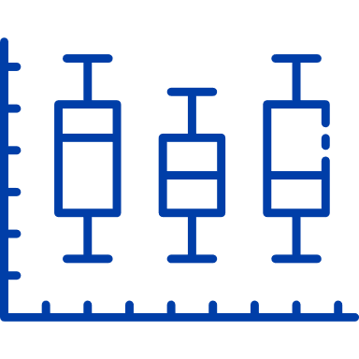
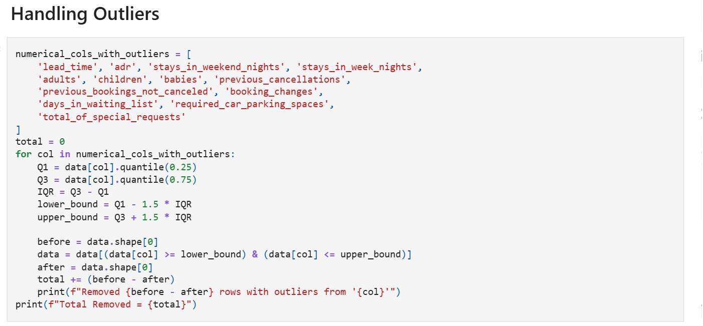

Outlier Detection & Removal
Techniques Applied:
Z-score analysis and Interquartile Range (IQR) for numerical fields
Visual inspection using boxplots and histograms

Slide 10
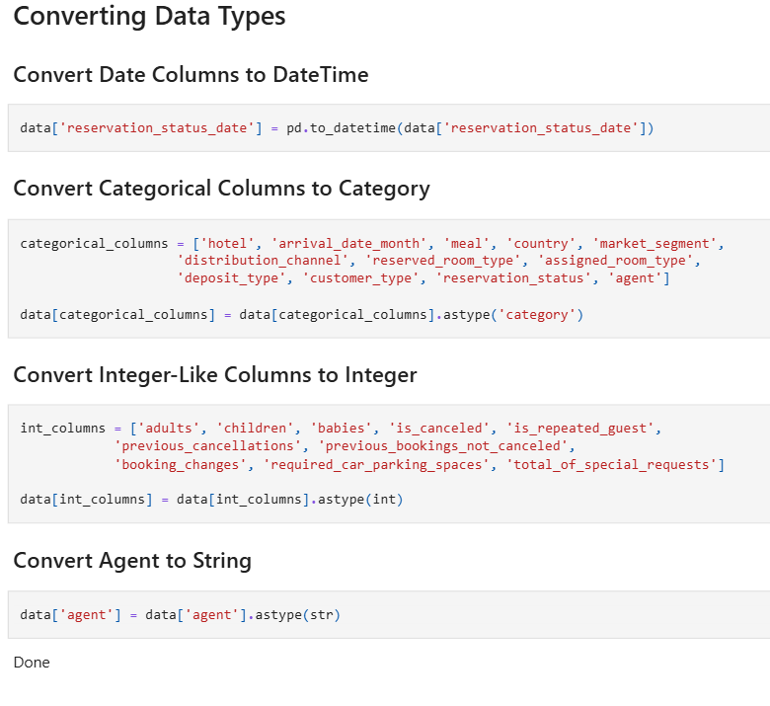


Data Type Standardization
Issues Identified & Resolved:
reservation_status_date → converted to datetime
Guest count fields → cast to int
Binary flags (is_canceled, is_repeated_guest) → ensured int (0/1)
Why It Matters:
Correct data types are essential for:
Efficient memory usage
Seamless visualization
Accurate machine learning model input

Slide 11

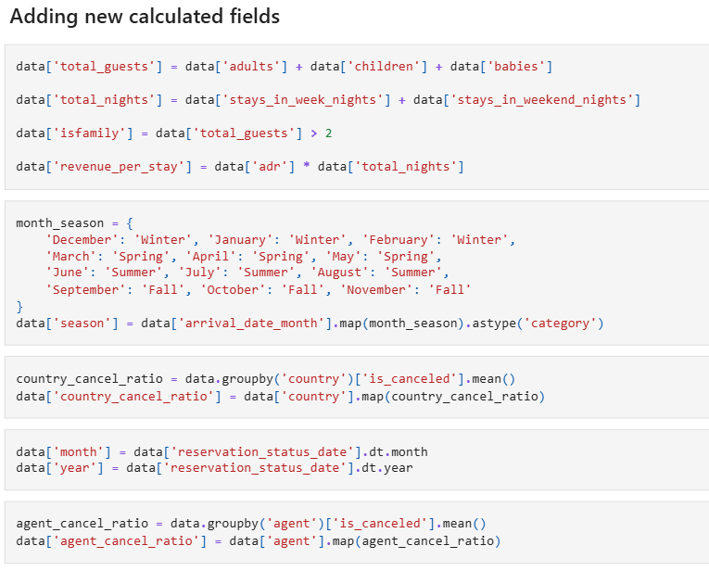

Feature Engineering
Created New Analytical Features:
total_guests | Sum of adults, children, and babies | Reflects total occupancy
stay_length | Weeknight + weekend stay duration | Measures booking length
season | Derived from arrival_date_month | Enables seasonal trend analysis
is_family | Flag if children or babies > 0 | Used to analyze family behaviors

Slide 12

Exploratory Data Analysis
(EDA)
Objective:
Explore data patterns, distributions, and relationships to uncover meaningful insights before modeling.
Key Focus Areas:
Booking behavior
Cancellation patterns
Customer demographics
Seasonal trends
Feature correlations

Slide 13


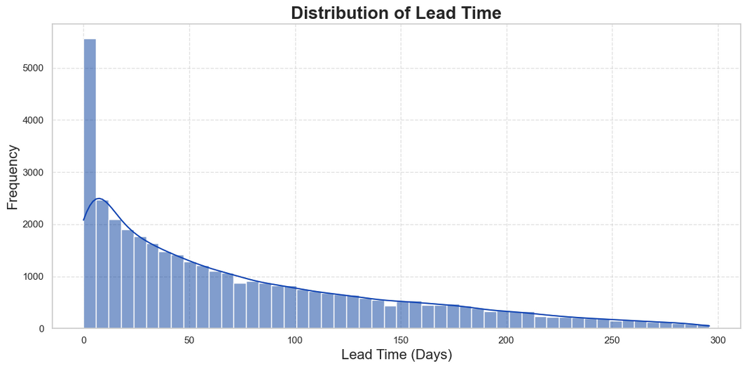
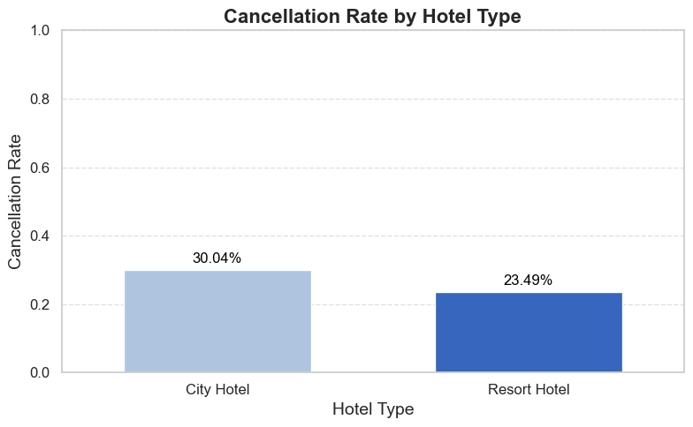
Cancellation Behavior Insights
Key Findings:
Overall Cancellation Rate: Around 37% of all bookings were canceled.
Higher Cancellation Rates Observed For:
City hotels compared to resort hotels.
Bookings made with longer lead times (advance reservations).

Slide 14
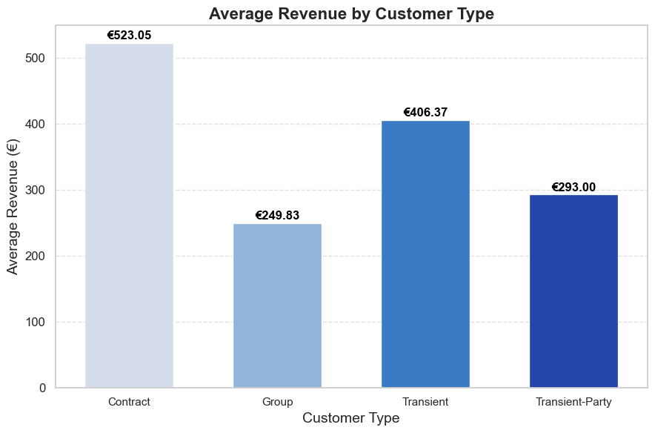

Guest Demographics & Booking Patterns
Insights:
Majority of bookings were for 2 adults.
Most bookings did not include children or babies.
Families preferred resort hotels, especially in summer.
Use Case:
Targeted marketing strategies for different guest types and seasons.

Slide 15

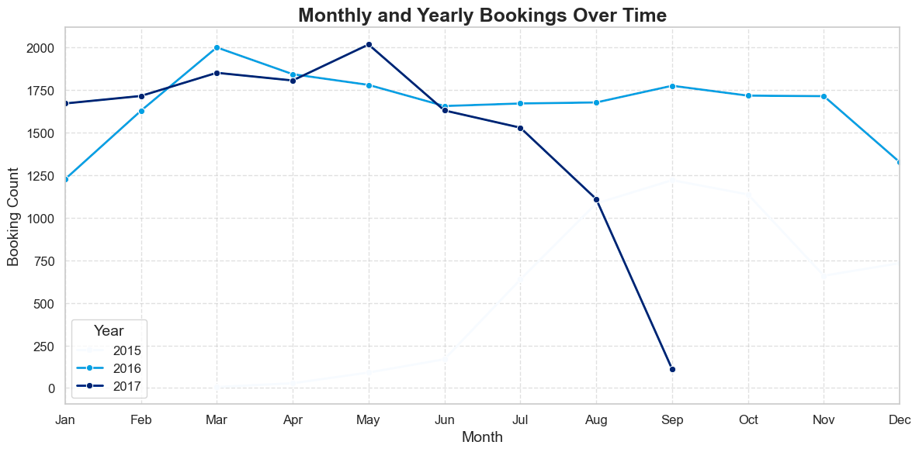


Seasonal and Monthly Trends
Insights:
Resort hotels peak in July–August; city hotels maintain steady demand.
Booking volume is seasonal and varies by month and hotel type.
Actionable Insight:
Adjust pricing and promotions based on seasonal demand

Slide 16

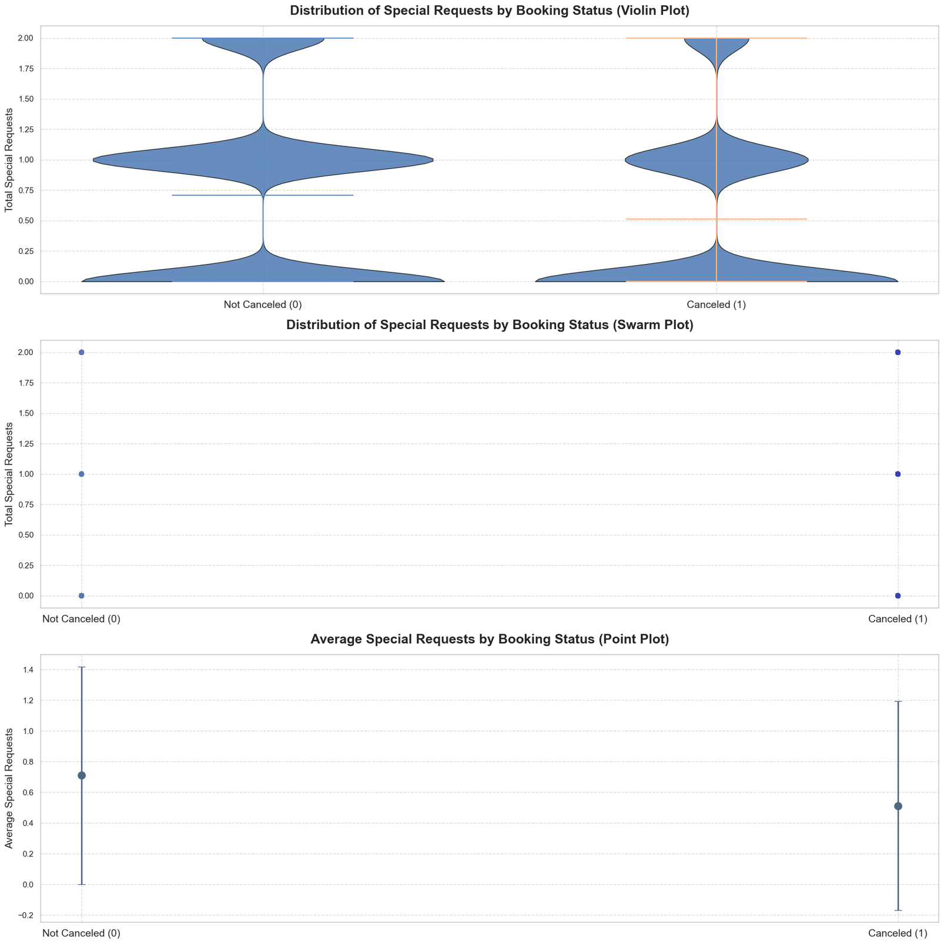

Special Requests and Behavior
Insights:
Guests with more special requests were less likely to cancel.
Higher special request count indicated higher engagement and commitment.
Actionable Strategy:
Use request data as a soft predictor for booking reliability.

Slide 17

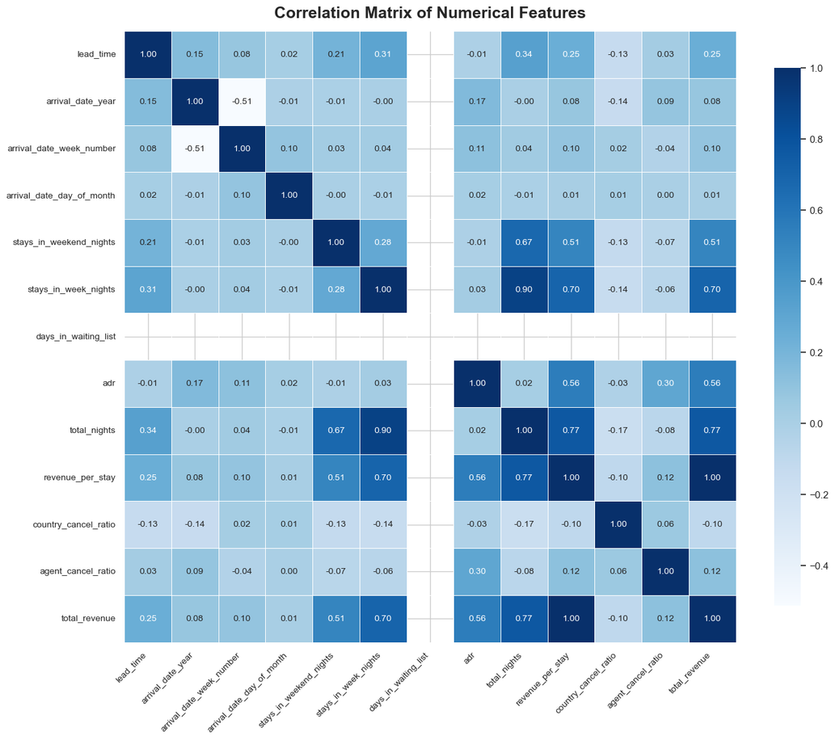
Correlation Analysis
Highlights:
lead_time shows a strong positive correlation with cancellations.
total_of_special_requests has a slight negative correlation.
Moderate correlations among duration, ADR, and repeat guest status.
Use in Modeling:
Supports feature selection for predicting cancellations.

Slide 18


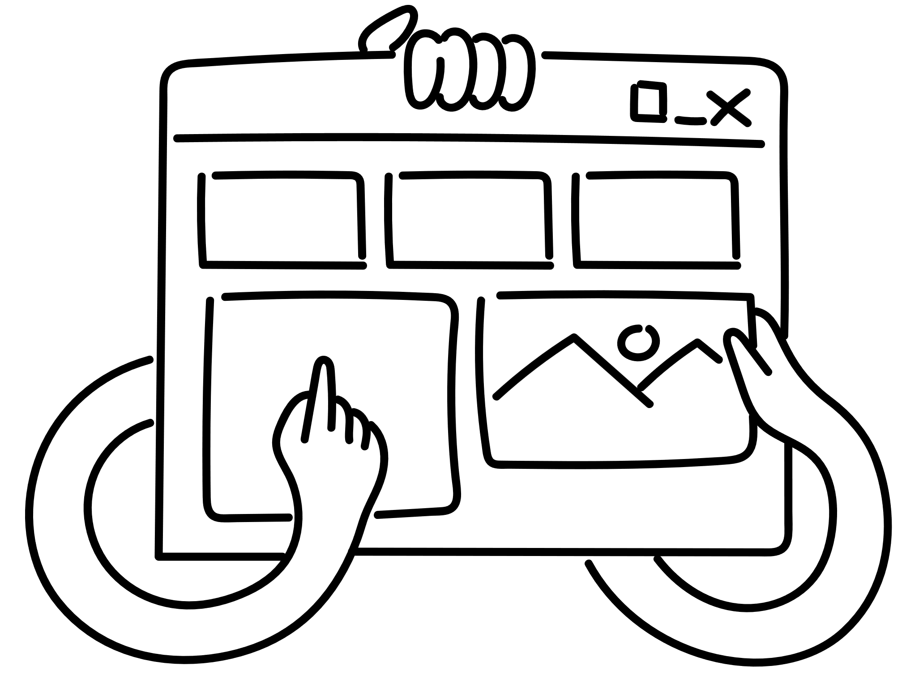
Dashboard Demo
Key Features:
Booking Trends Overview:
View monthly bookings, cancellations, and occupancy rates.
Guest Segmentation:
Filter by customer type (e.g., Transient, Contract, Family) to see behavior and revenue.
Market Insights:
Visualize revenue and cancellations by country or region.
Revenue & ADR Monitoring:
Track average daily rate, total revenue, and performance by room type or season.
Cancellation Predictors:
Interactive lead time, deposit type, and special request correlation analysis.
Real-Time Filters:
Filter dashboard by hotel type, year, season, booking channel, and more.

Slide 19
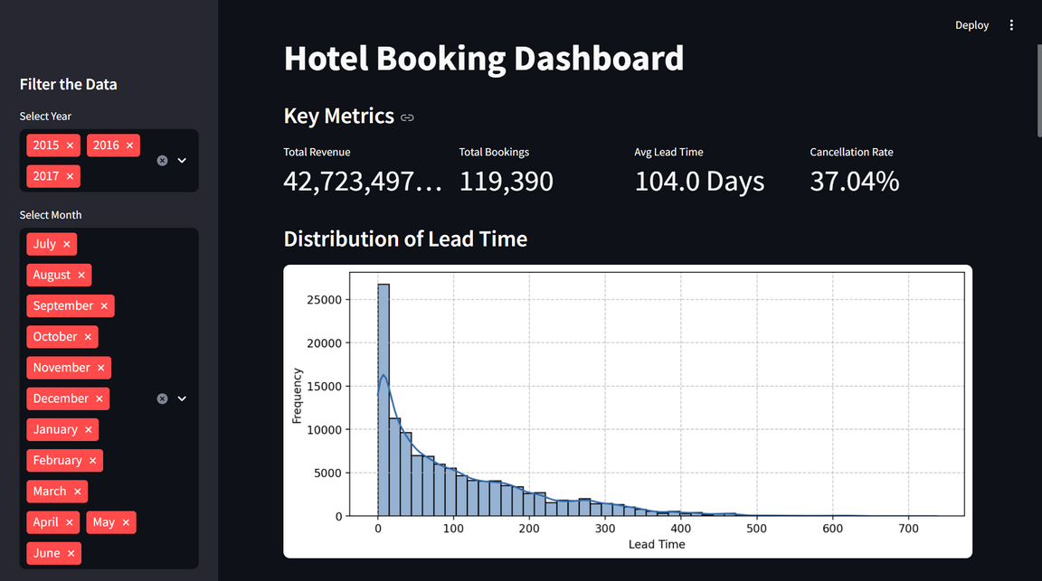
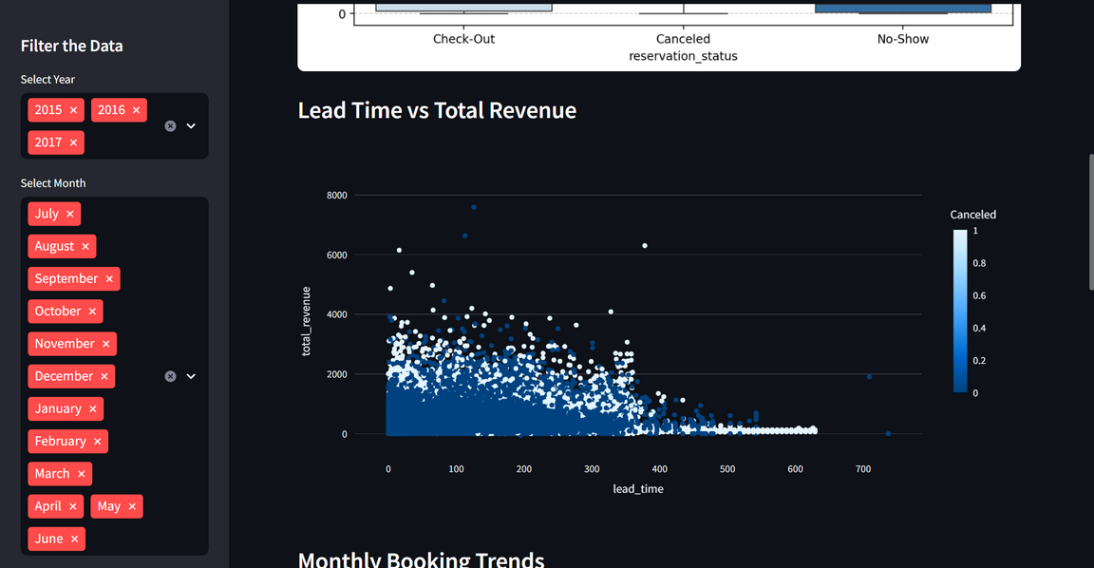
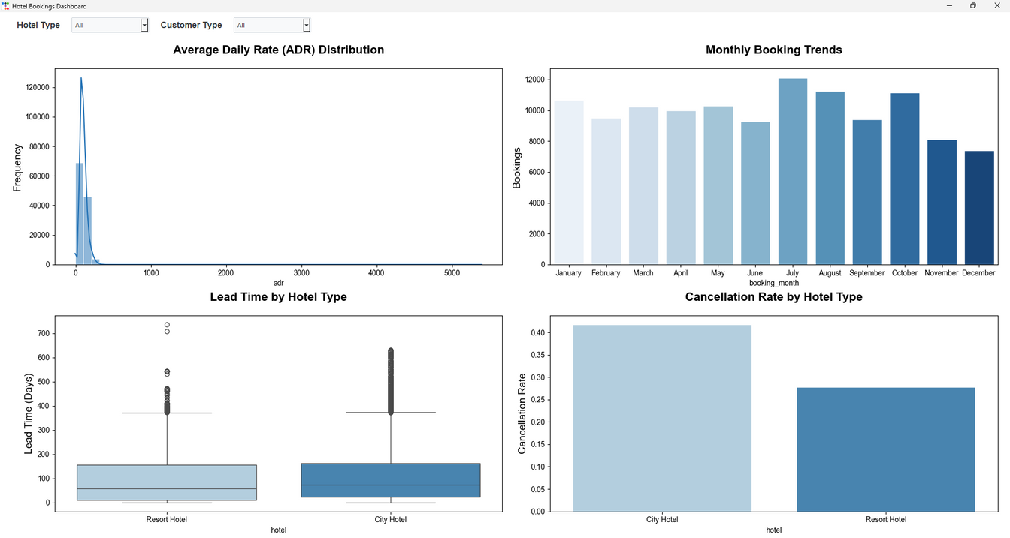

streamlit
GUI Version using tkinter and ttkbootstrap

Slide 20


Final Recommendations
Reduce Cancellations:
Require deposits or promote non-refundable bookings, especially for long lead-time reservations.
Use automated reminders and flexible rebooking policies to retain early bookers.
Leverage Customer Segmentation:
Retain Contract customers with loyalty offers and B2B incentives.
Target Transient customers with cancellation reduction tactics (e.g., personalized offers).
Use Special Requests as Loyalty Signals:
Encourage guests to make requests during booking to increase engagement.
Use request volume to identify and reward loyal guests.

Slide 21

Optimize for Seasonality:
Implement dynamic pricing based on booking season.
Adjust staffing and promotional strategies to match seasonal demand.
Diversify and Strengthen Booking Channels:
Reduce dependency on OTAs by boosting direct bookings.
Expand corporate and travel agency partnerships.
Enforce Smart Deposit Policies:
Require deposits for high-risk market segments.
Offer discounts for non-refundable bookings to lock in revenue early.
Regional Customization:
Focus marketing efforts on high-revenue countries.
Introduce stricter policies in regions with high cancellation rates.

Slide 22

Finally... Thank You!
May your bookings be high, your cancellations be low, and your data always clean!

